Slide 1

AI DevOps Assistant
AI-Assisted User Story Generator: Automating Agile Documentation
Presenter: Aye Khine Lwin (140747)
Subject: Gestão de Projetos Ágeis (GP_03913) Instructor: Professor Miguel Ângelo da Silva
Institution: ISCTE | June 21, 2026

Slide 2


Problem & Objective
The Core Problem
Project Objective
Manual backlog refinement and requirement gathering create massive overhead and inconsistencies for Agile teams.
Build an AI-powered solution to instantly convert rough text ideas into Professional User Stories and Acceptance Criteria.
Product Owners spend significant manual effort drafting standardized documentation rather than focusing on strategy.
Designed for SME teams (5–15 members) to lower AI adoption barriers and improve sprint efficiency.

Slide 3
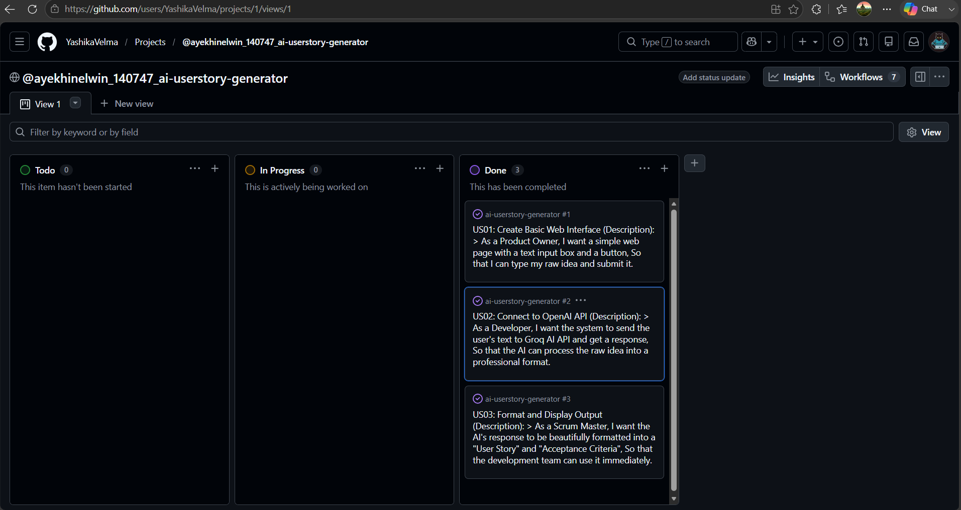

Agile Project Orchestration
Iterative Execution
→
Scrum Adoption: Managed via iterative sprint blocks avoiding monolithic builds.
→
Pipeline Priority: Developed MVP Frontend UI first, followed by Groq AI integration.
→
Kanban Management:GitHub Projects which operated as Kanban utilized for strict Todo, In Progress, Done.
→
Core Backlog: Integration of US01 (UI), US02 (API), and US03 and separating them into tasks.

Slide 4






System Architecture
Frontend
AI Engine
Security
Built with Streamlit for rapid prototyping. Simplifies interactive interface generation without complex HTML/CSS overhead.
Driven by Groq API running Llama-3.3-70b. Engineered prompts force strict "As a... I want... So that..." schemas.
Leveraged Streamlit Secrets for secure Groq_API_KEY management. Avoids hardcoded tokens in source code.

Slide 5
DevOps CI/CD
Automated quality control via .github/workflows/main.yml triggered on every push.
**The next image will be the code description of CI/CD code that mentioned here.
→
Checkout: Pulls latest code iterations.
→
Setup: Configures stable Python 3.10 runtime.
→
Dependencies: Synchronizes system packages.
→
Syntax: Executes py_compile to block bugs.

Slide 6
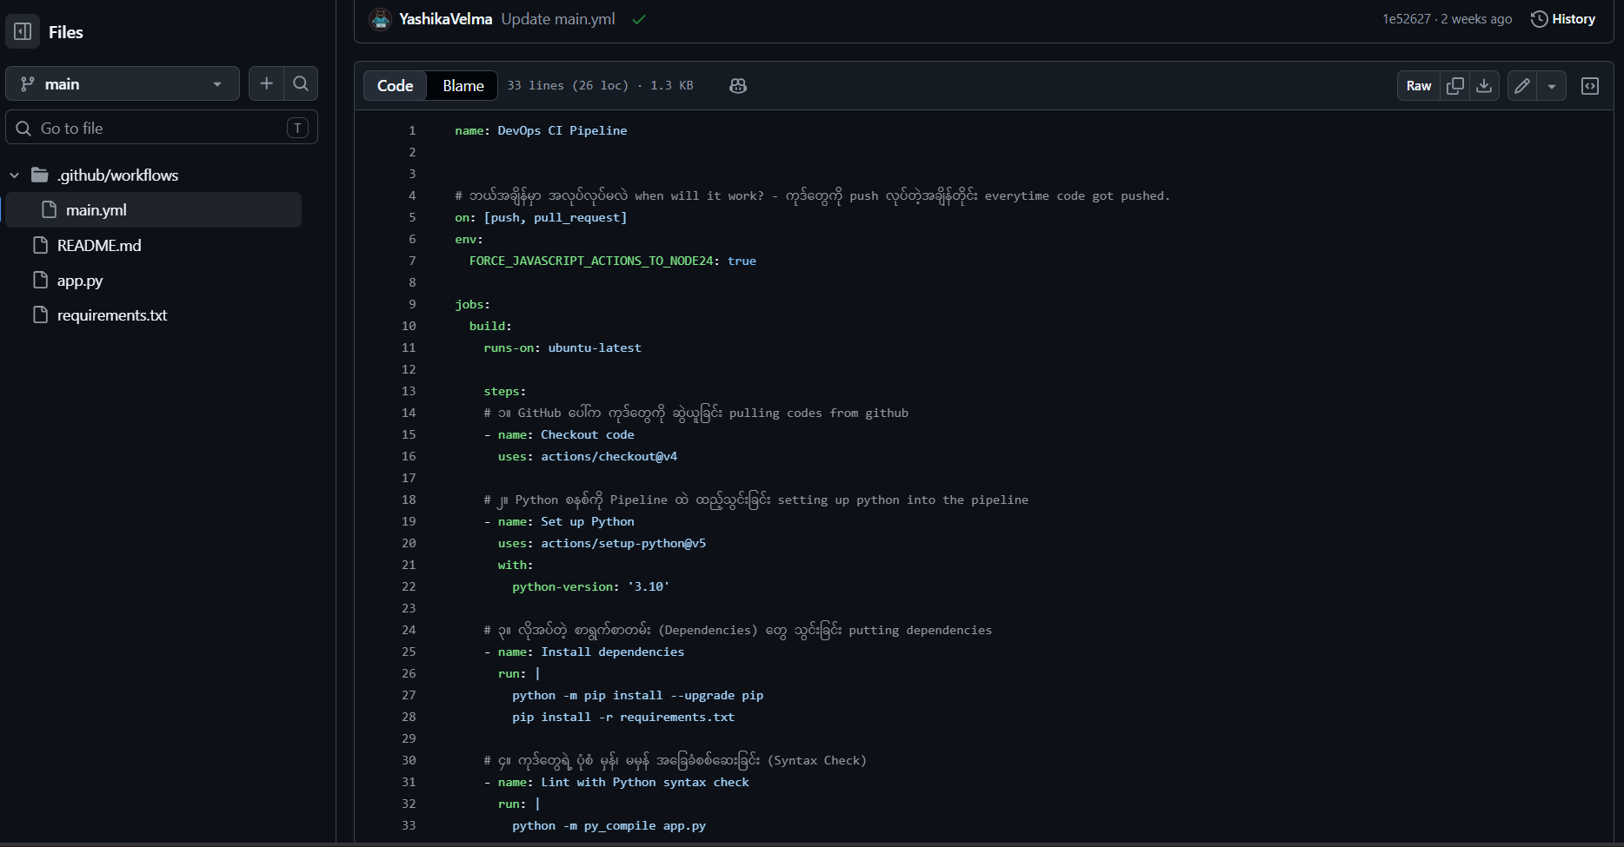
This Screenshot is the main code file of CI/CD { .github/workflows/main.yml }

Slide 7
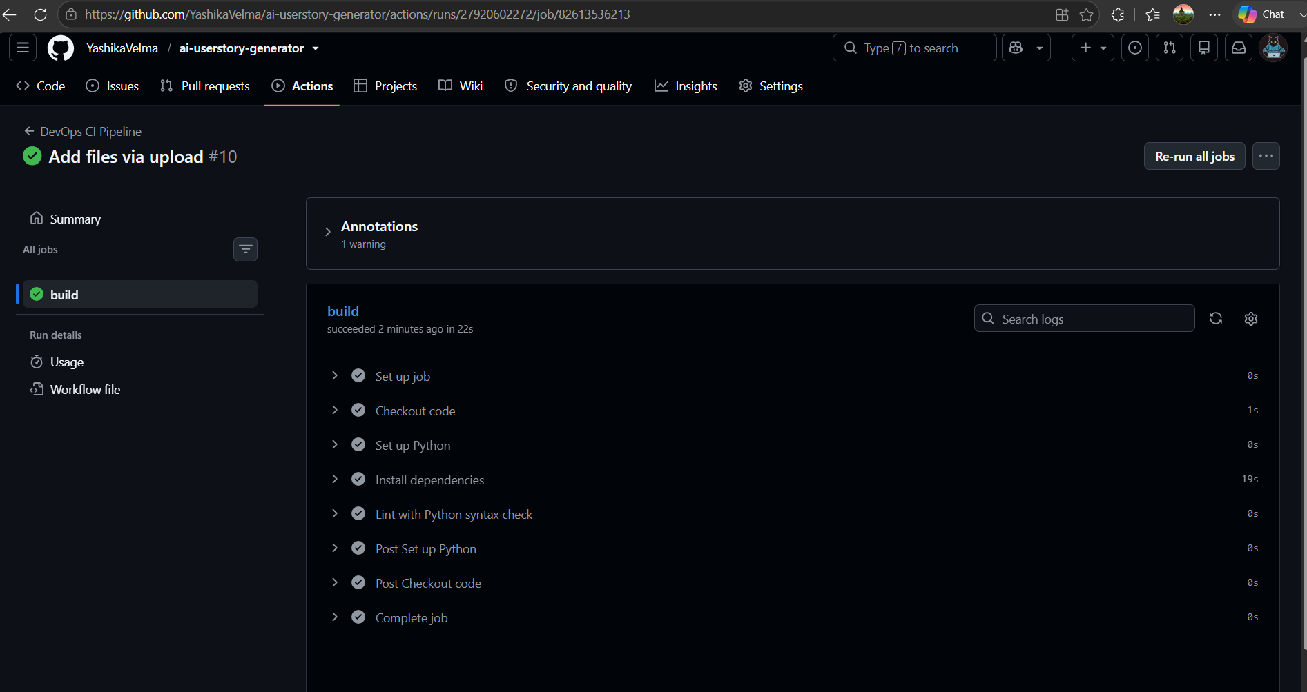
This Screenshot is the successful configuration of CI/CD. After I commit something whether file upload or code rewrite, It check itself and run all the jobs so that no bad code will be deployed to the live app application.

Slide 8



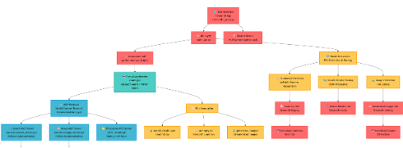
Real-Time Output Demo
Input Prompt
AI Generated Result
"The use of AI can enhance the performance of software engineering systems"
User Story: As a software engineering lead, I want to integrate AI into our systems to optimize tasks, so that we improve performance and reduce manual errors.
Criteria: Successful pipeline binding, 20% drop in manual tasks, and 15% latency reduction.

Slide 9
Project Conclusions
Technical synthesis focuses on Security-First environments and refining robust DevOps parameterization to overcome pipeline roadblocks.
Successful delivery proves that software excellence requires a mixture of smart logic, rigorous validation frameworks, and automated continuous delivery flow.
Thank you for your attention.

Slide 10

Image Sources
→
View 1 · @ayekhinelwin_140747_ai-userstory-generator
Source: github
→
ai-userstory-generator/.github/workflows/main.yml at main · YashikaVelma/ai-userstory-generator
Source: github.com
→
https://miro.medium.com/v2/resize:fit:5108/1*pWlj0J1FjA8flxqoWp01QQ.png
Source: medium.com

